Slide 1

Pet Shop - ITT season15

Slide 2


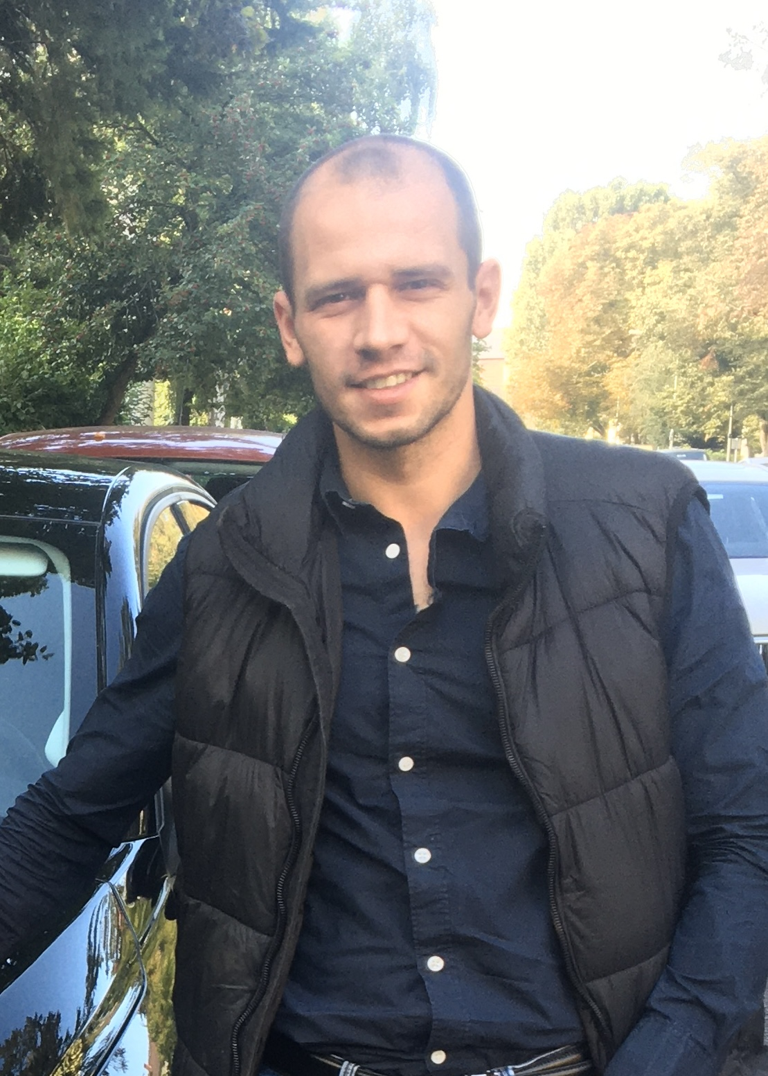
ABOUT US:
Georgi Kalachev Boil Radev

Slide 3

What the project costed
2800 lines of script
7 days
5 sleepless nights
3 packs of energy drinks

Slide 4


USED TECHNOLOGIES
JAVA 17
Spring Boot
Spring Rest
Spring Validation
Maven
Tomcat
Lombok
Hibernate
JAVA Mail Sender
Bcrypt
Swagger
Log4J2
IntelliJ
Postman
GIT
MySQL
MySQL Workbench

Slide 5
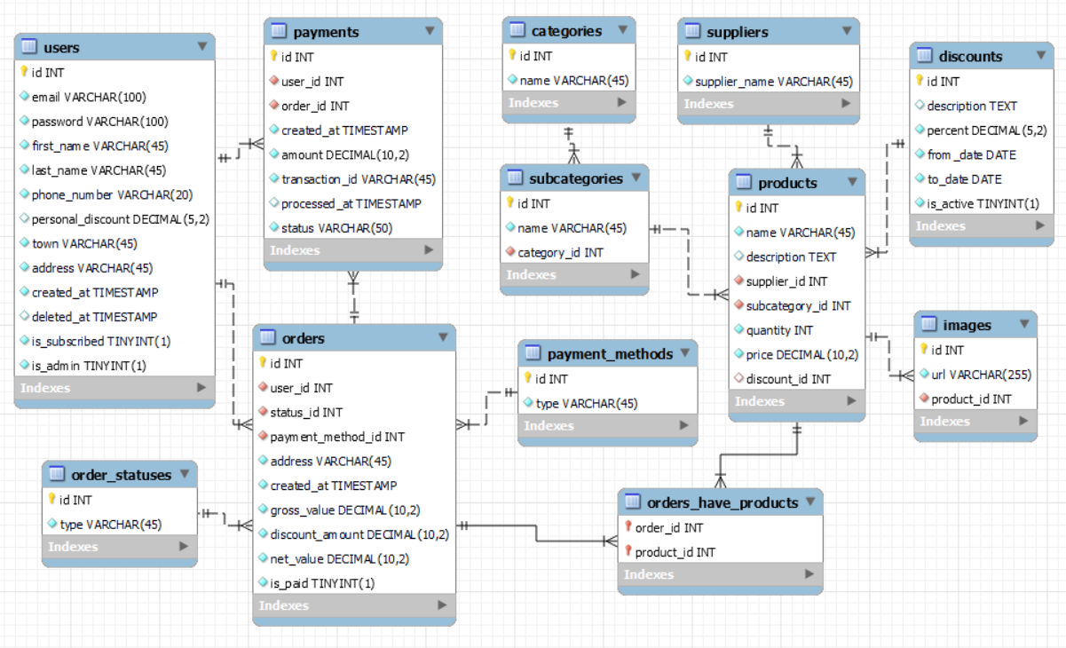

Slide 6
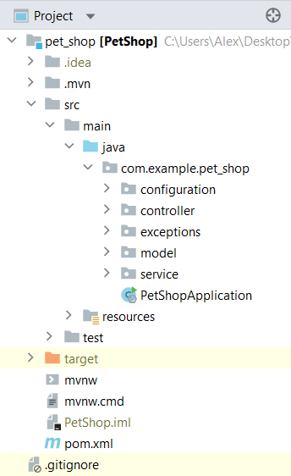
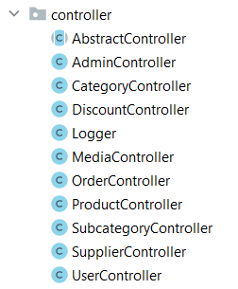
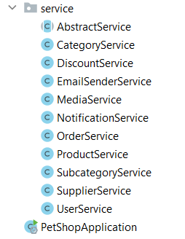
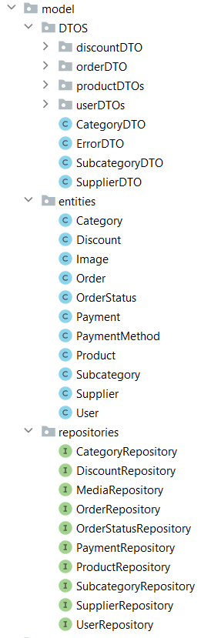
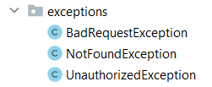

PROJECT CLASS STRUCTURE

Slide 7
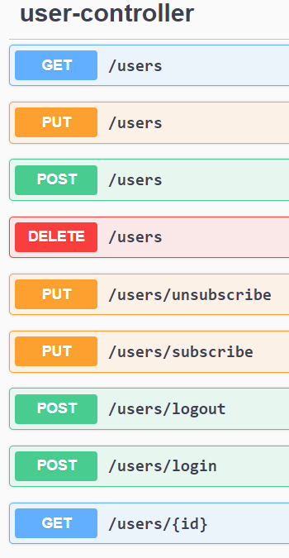
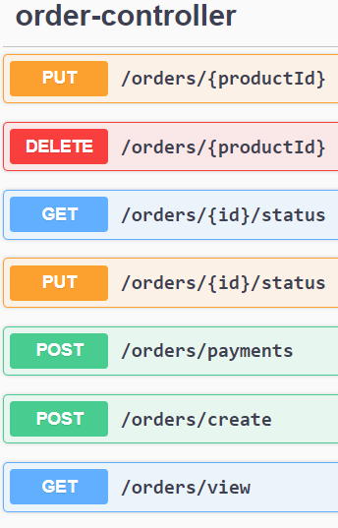
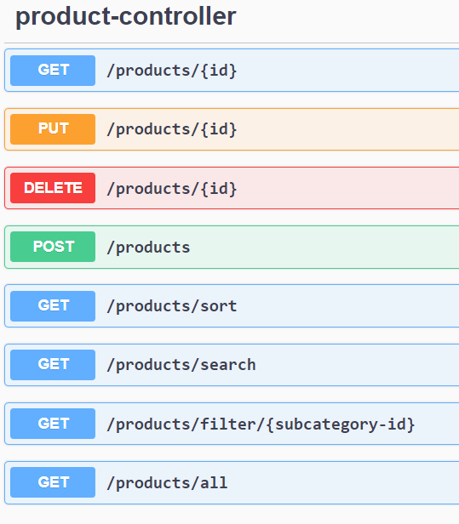
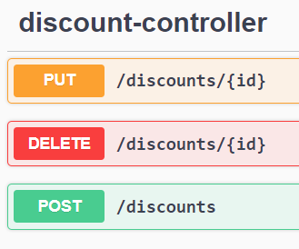
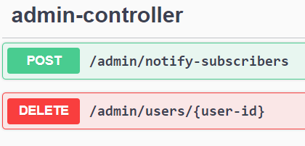

Slide 8


Slide 9


Slide 10


